Slide 1
LP30 solution NMR
09-05-2024
LP30 in a plastic tube inserted into a J-young NMR tube with DMSO for locking.

Slide 2
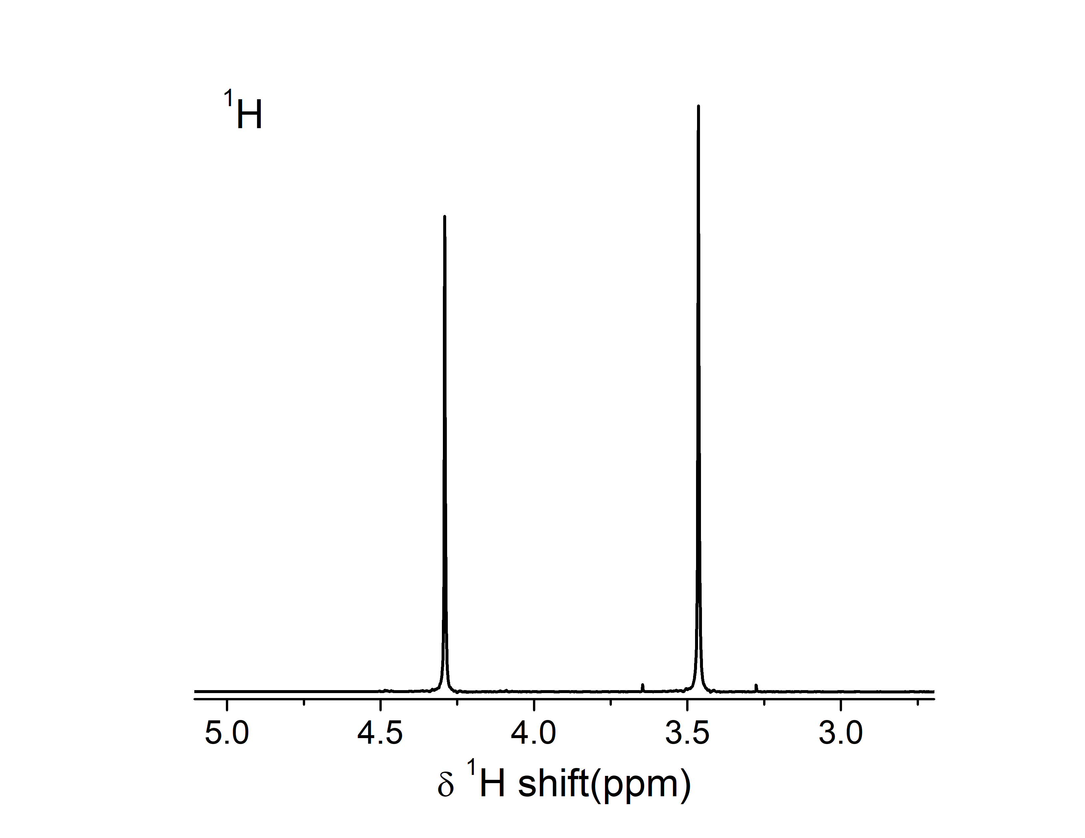
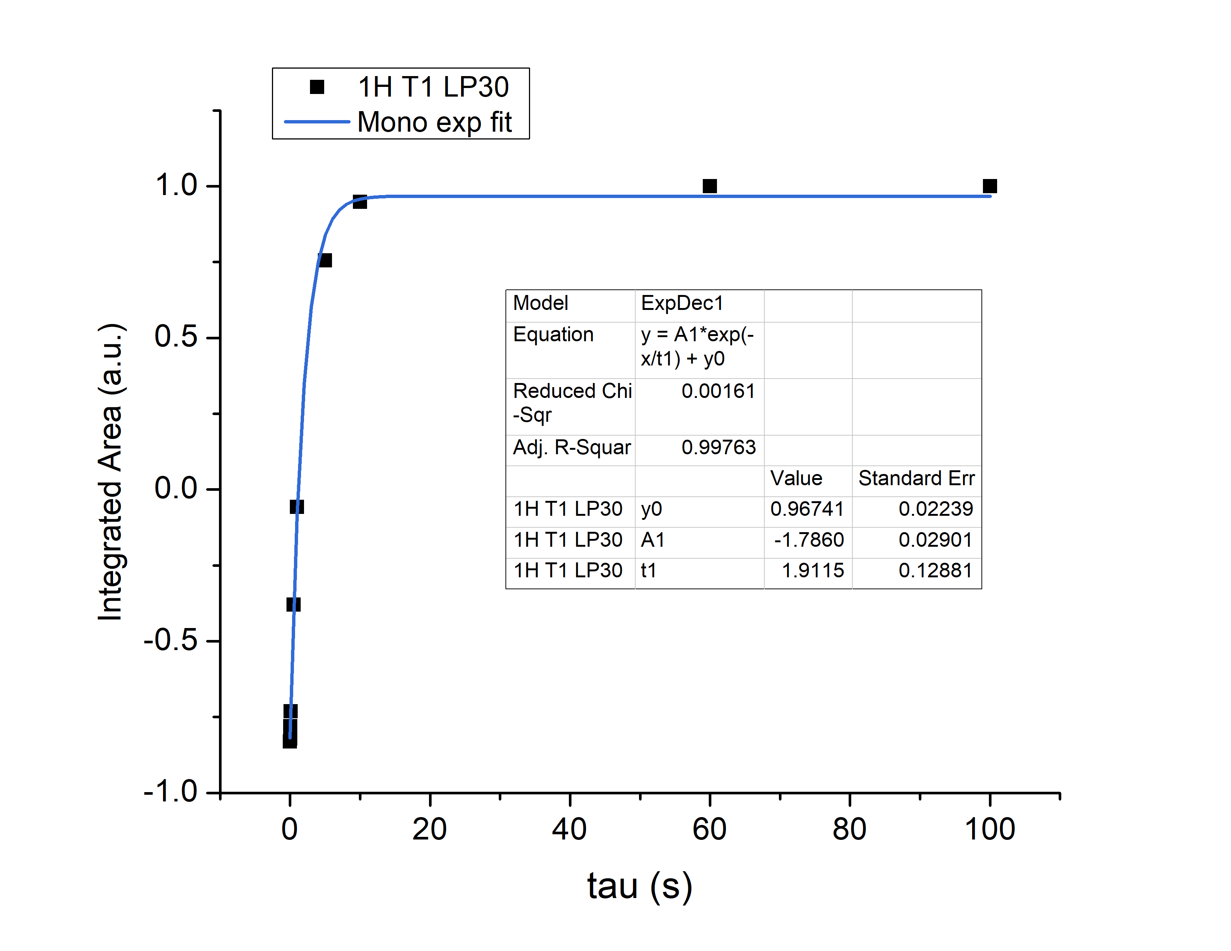
¹H LP30
O1p= 3.884 ppm

Slide 3
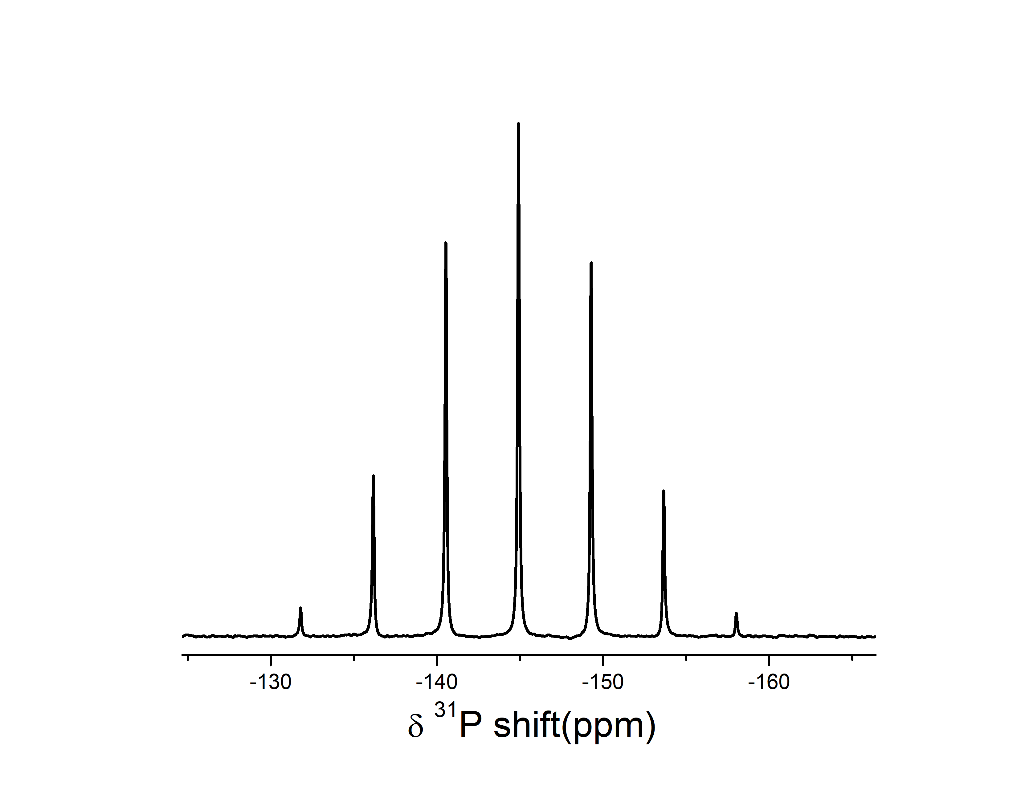
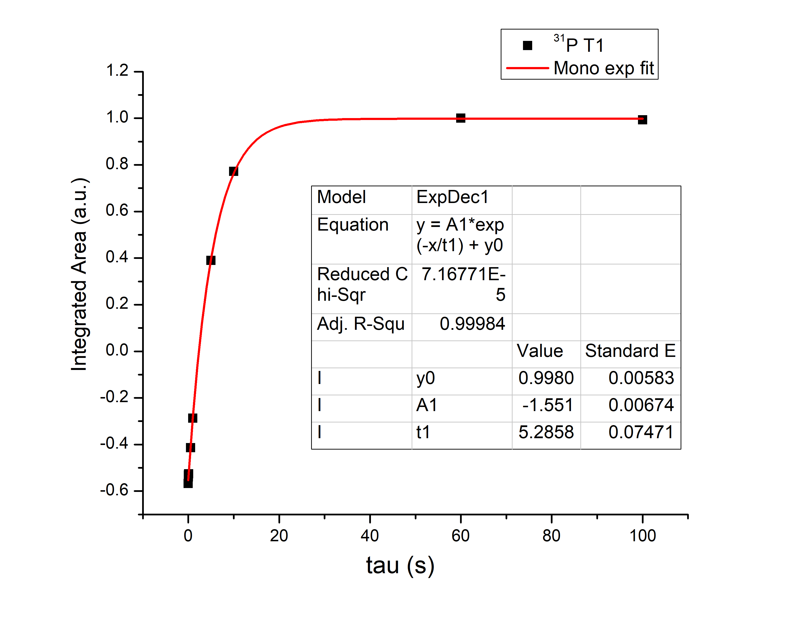
³¹P LP30
O1p= -144 ppm

Slide 4
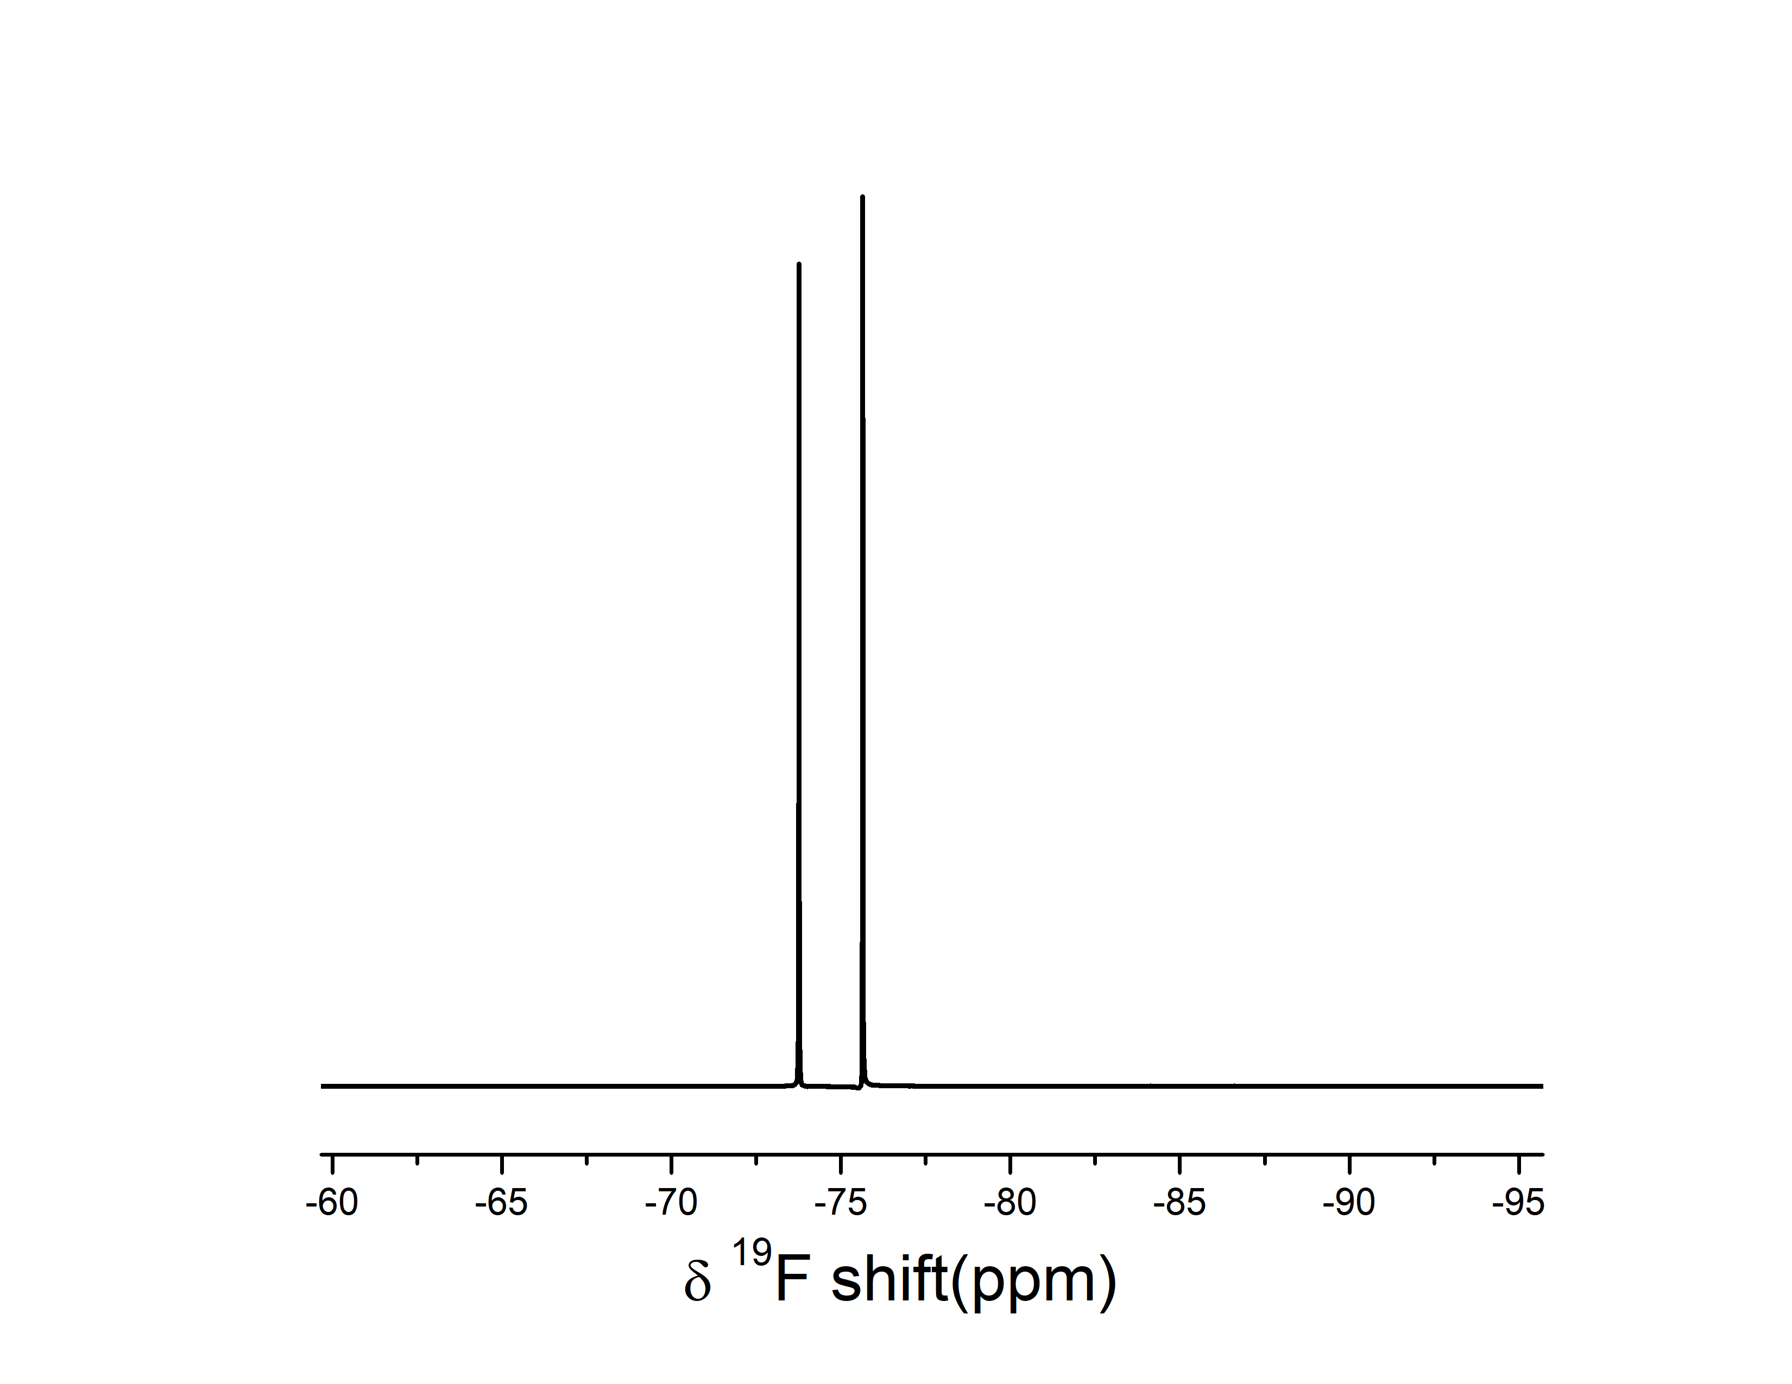
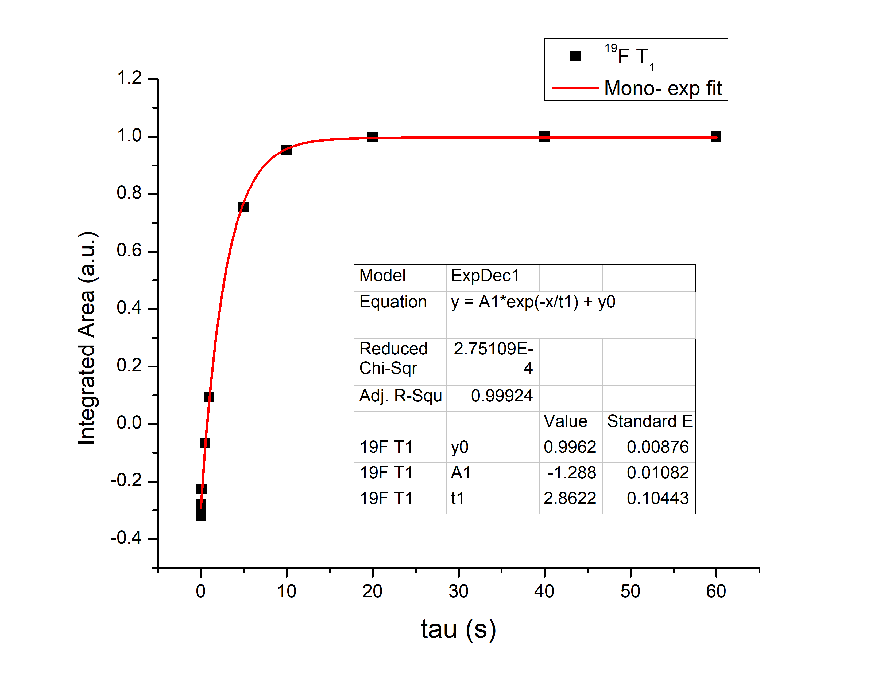
¹⁹F LP30
O1p= -74.74 ppm

Slide 5
PF6 in EC:PC +H2O solution NMR
09-05-2024
By Pablo- for manuscript reviewer comments
in a plastic tube inserted into a J-young NMR tube with DMSO for locking.

Slide 6
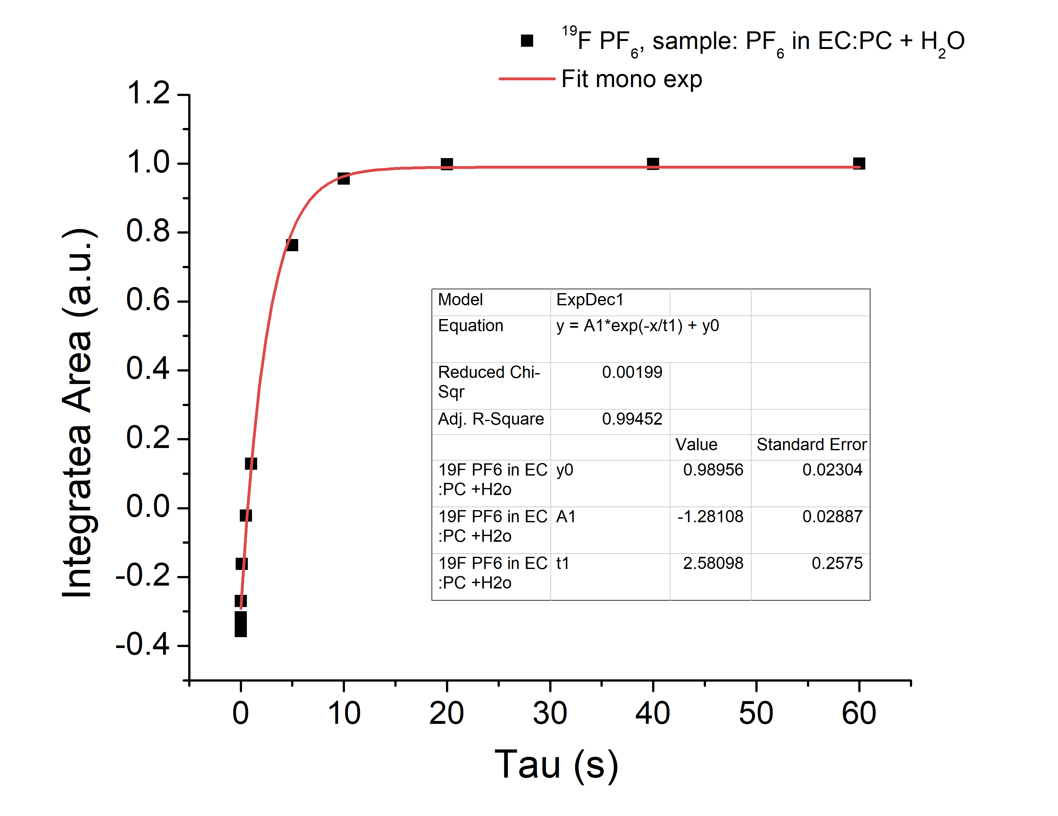
19F
LP30

Slide 7
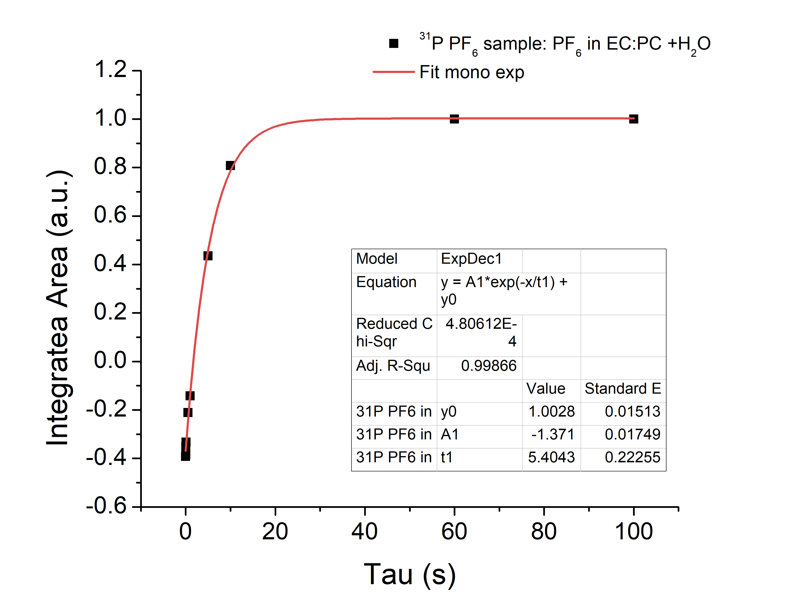
LP30

Slide 8
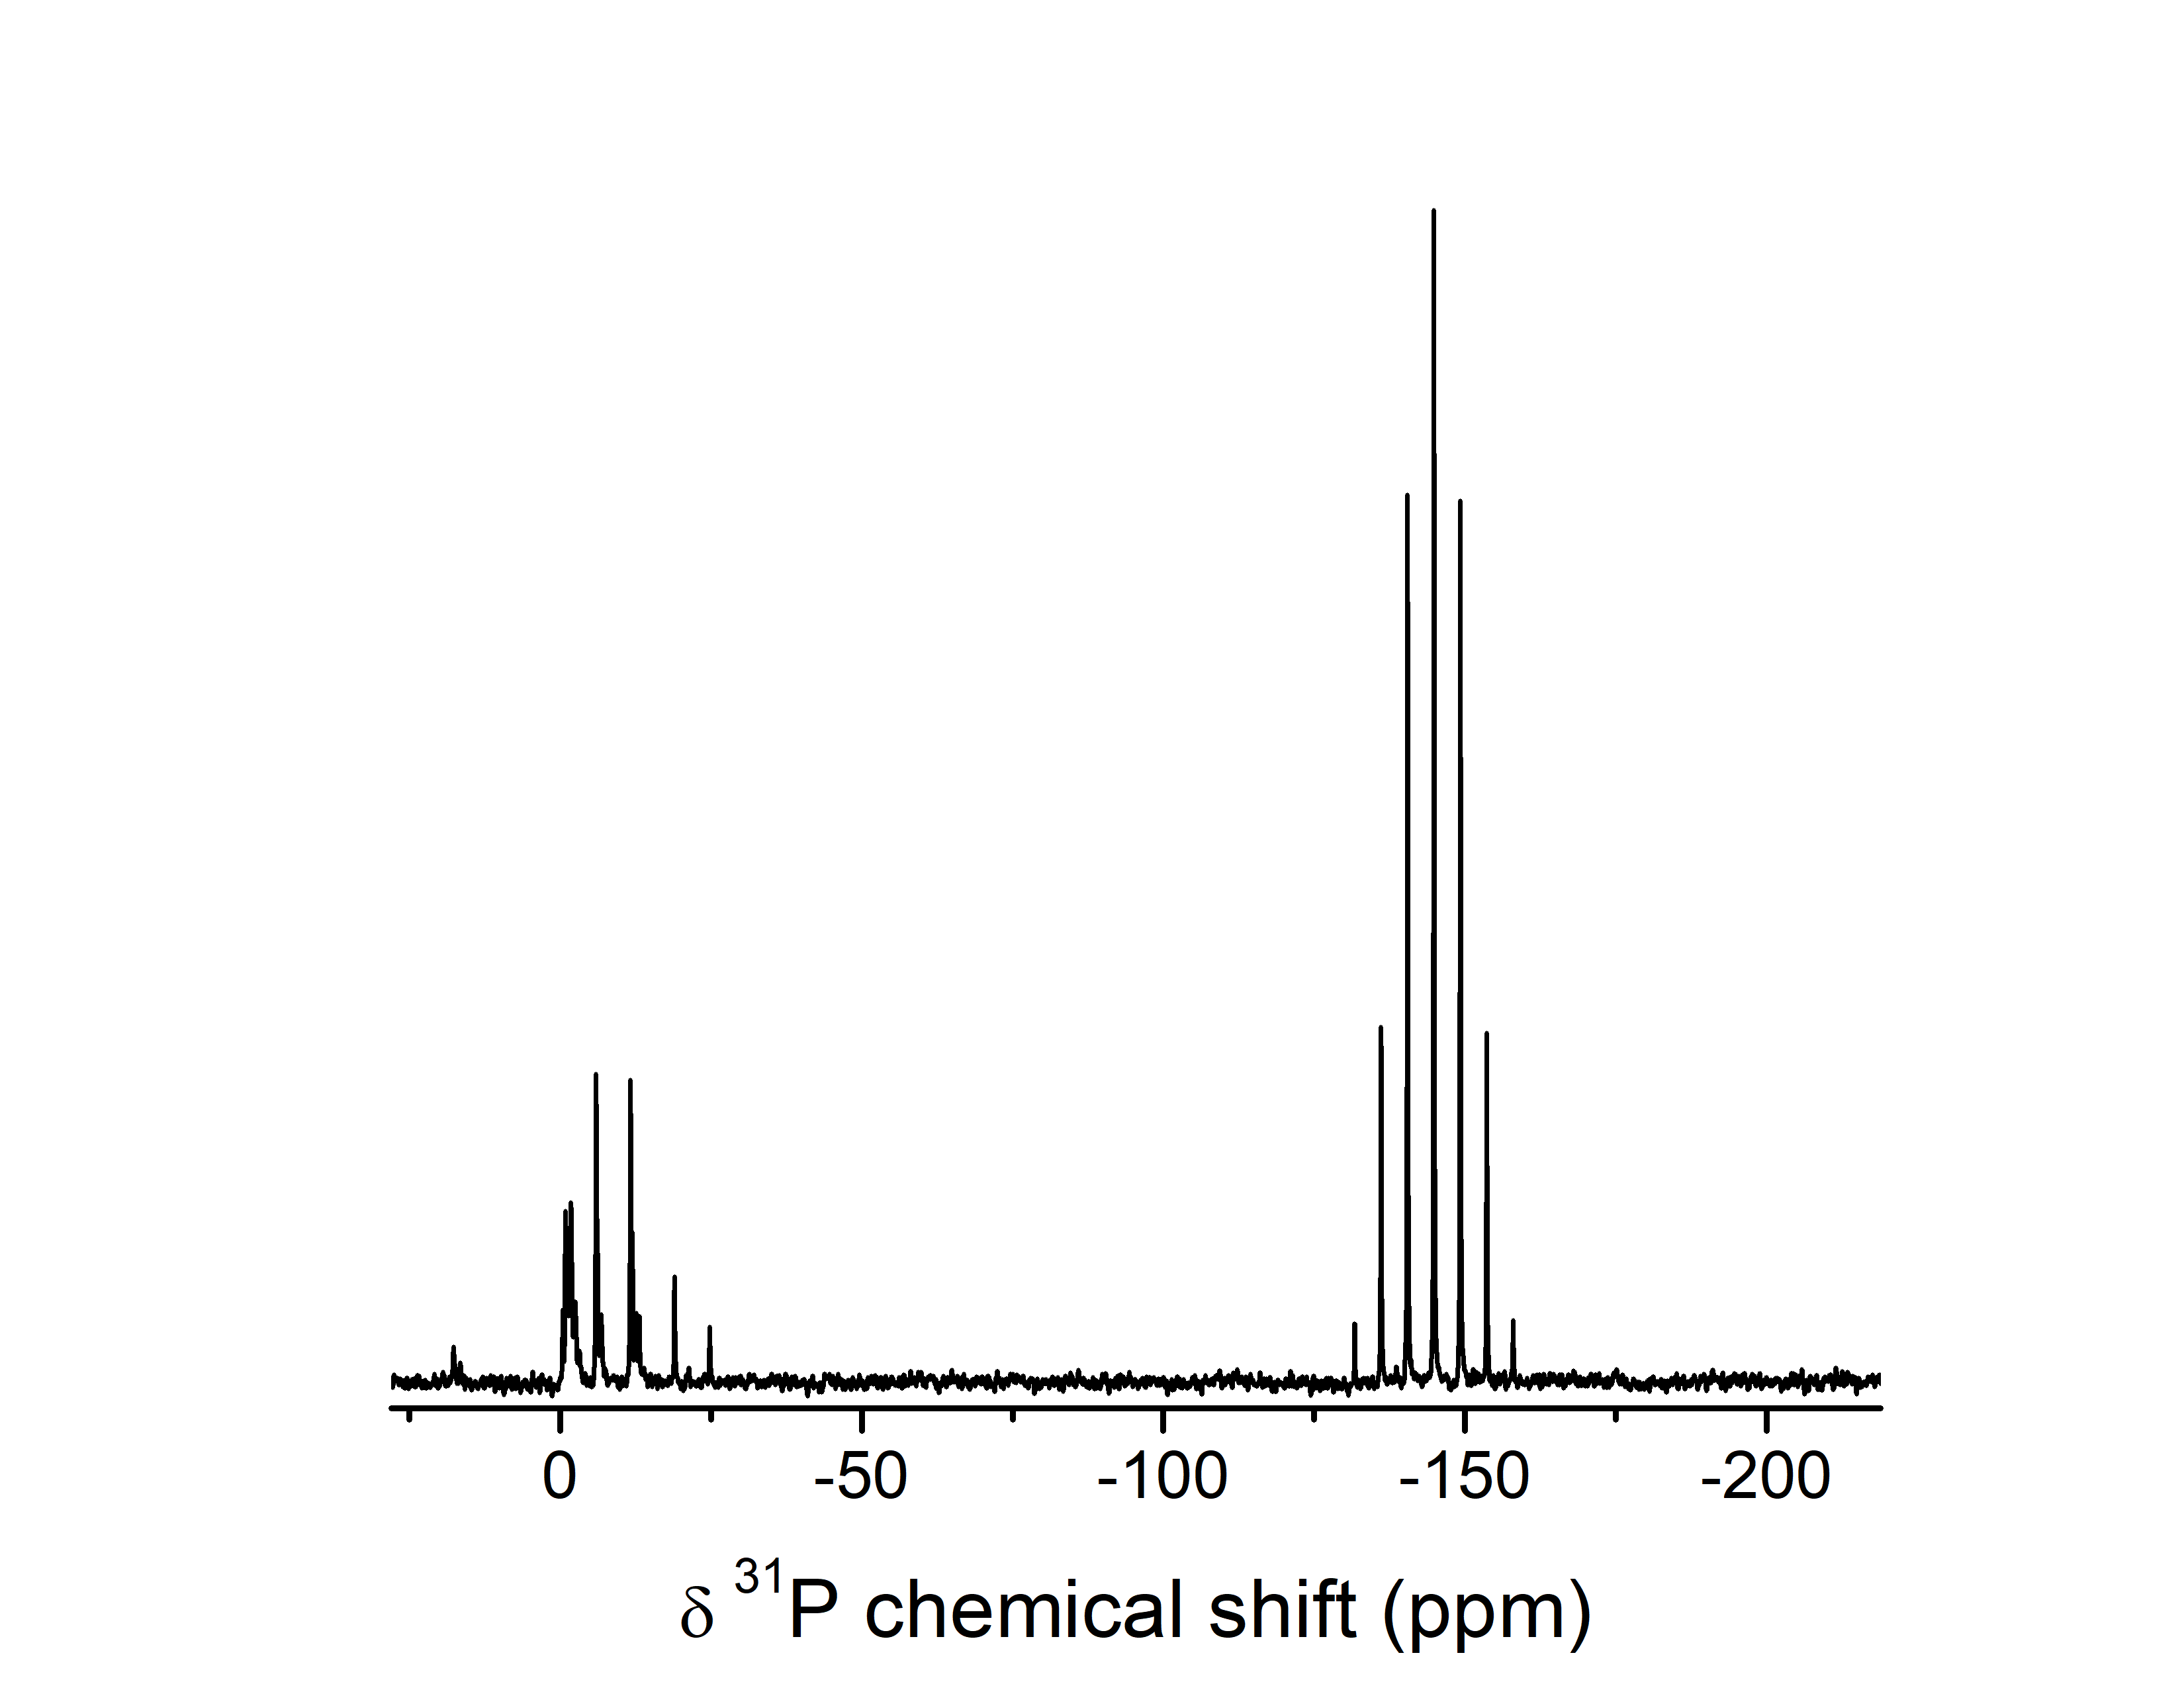
³¹P

Slide 9
LP30 solution NMR benchtop
10-04-2024
LP30 in a plastic tube inserted into a J-young NMR tube with DMSO for locking.- same sample that was used for high resolution

Slide 10
¹H LP30
O1p= 3.884 ppm

Slide 11
Solution NMR HF, Li/Na/K salts (Cam)
June 2023

Slide 12
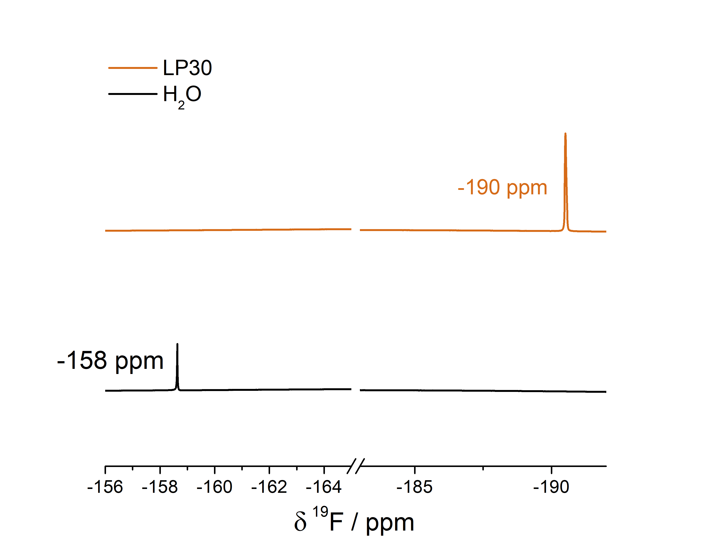
¹⁹F Solution NMR: Effects of HF Acid Addition on H2O and LP30
Addition of approximatly 0.5 mM of HF acid to H₂O and LP30 (±5 μL)
The sample was transferred to a plastic capillary and placed within a j-Young’s capillary along with DMSO-d₆ for locking purposes.

Slide 13
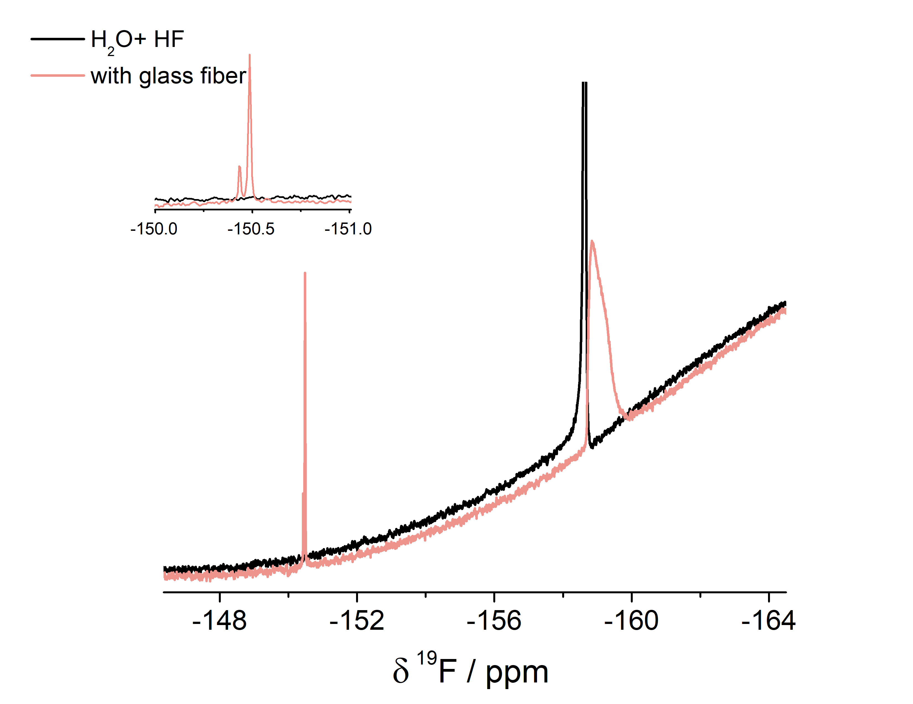
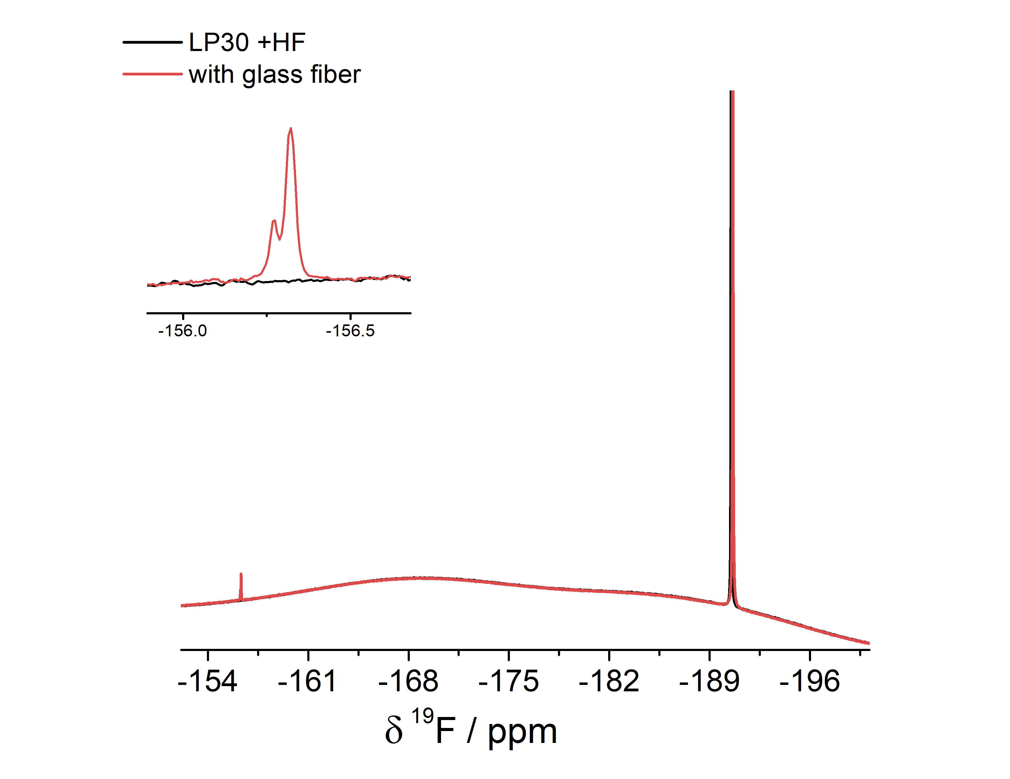
Addition of 0.3 mg glass fiber separator
HF
-158 ppm
HF
-190 ppm
LiBF₄
-156 ppm
LiBF₄
-150 ppm

Slide 14
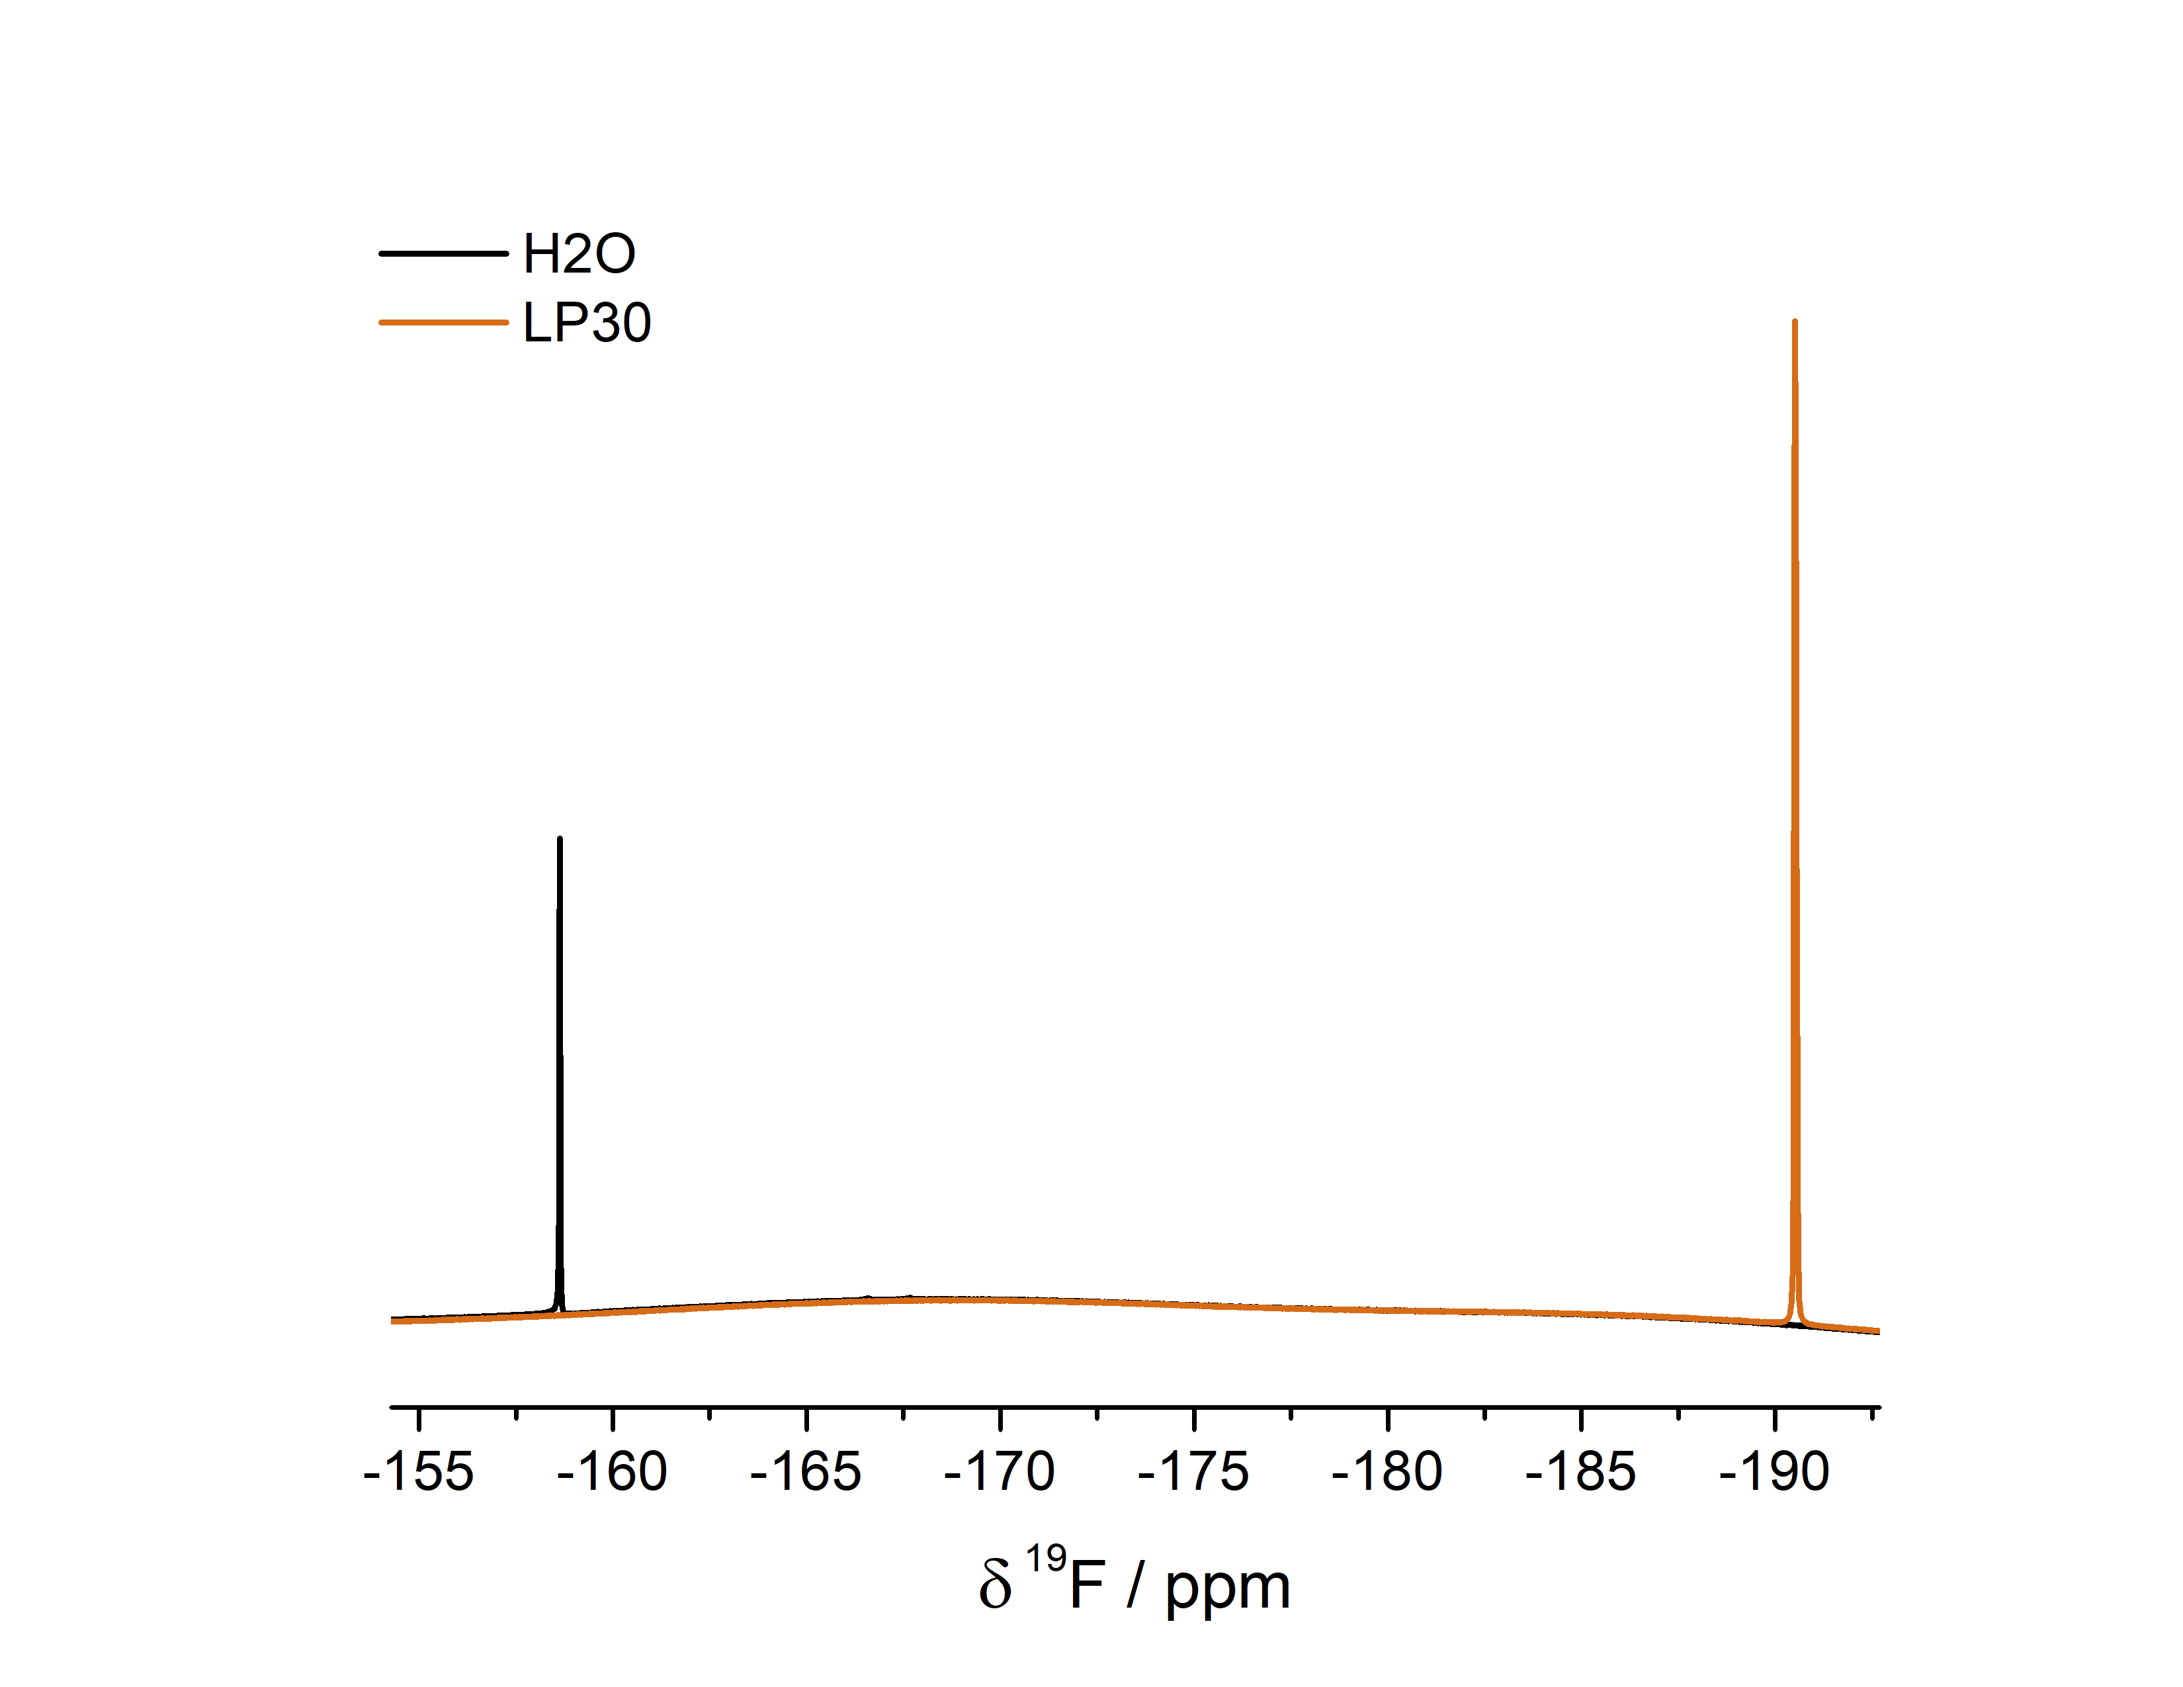
HF solution

Slide 15
Cam’s samples

Slide 16
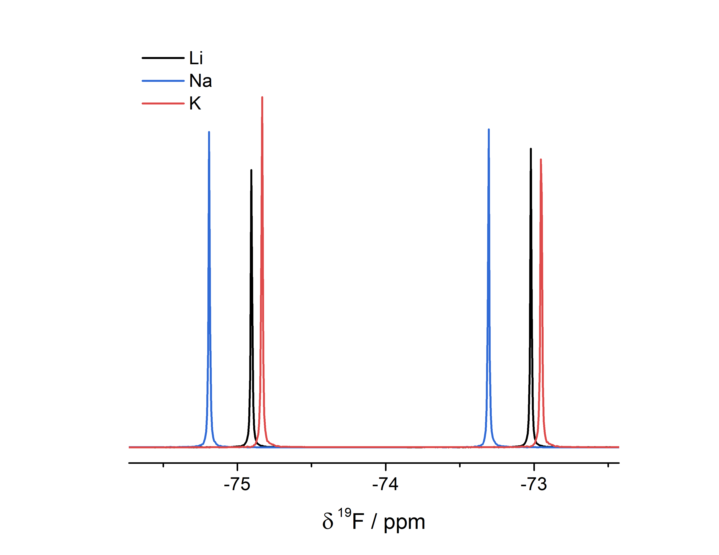
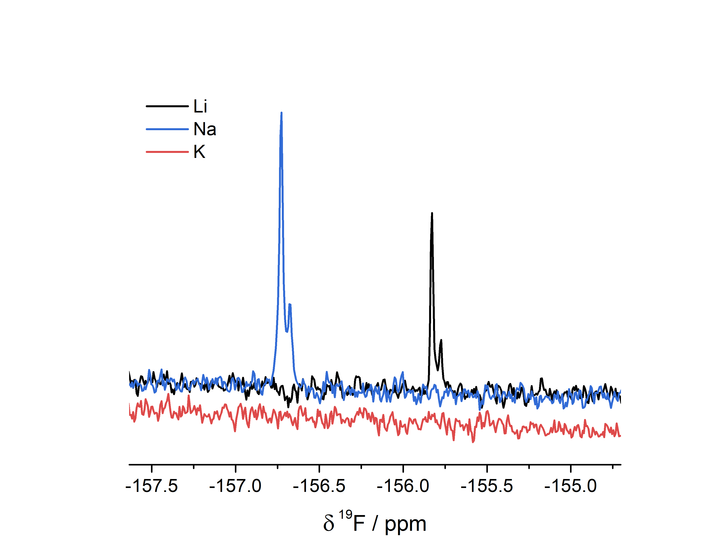
Li/Na/K salts

Slide 17
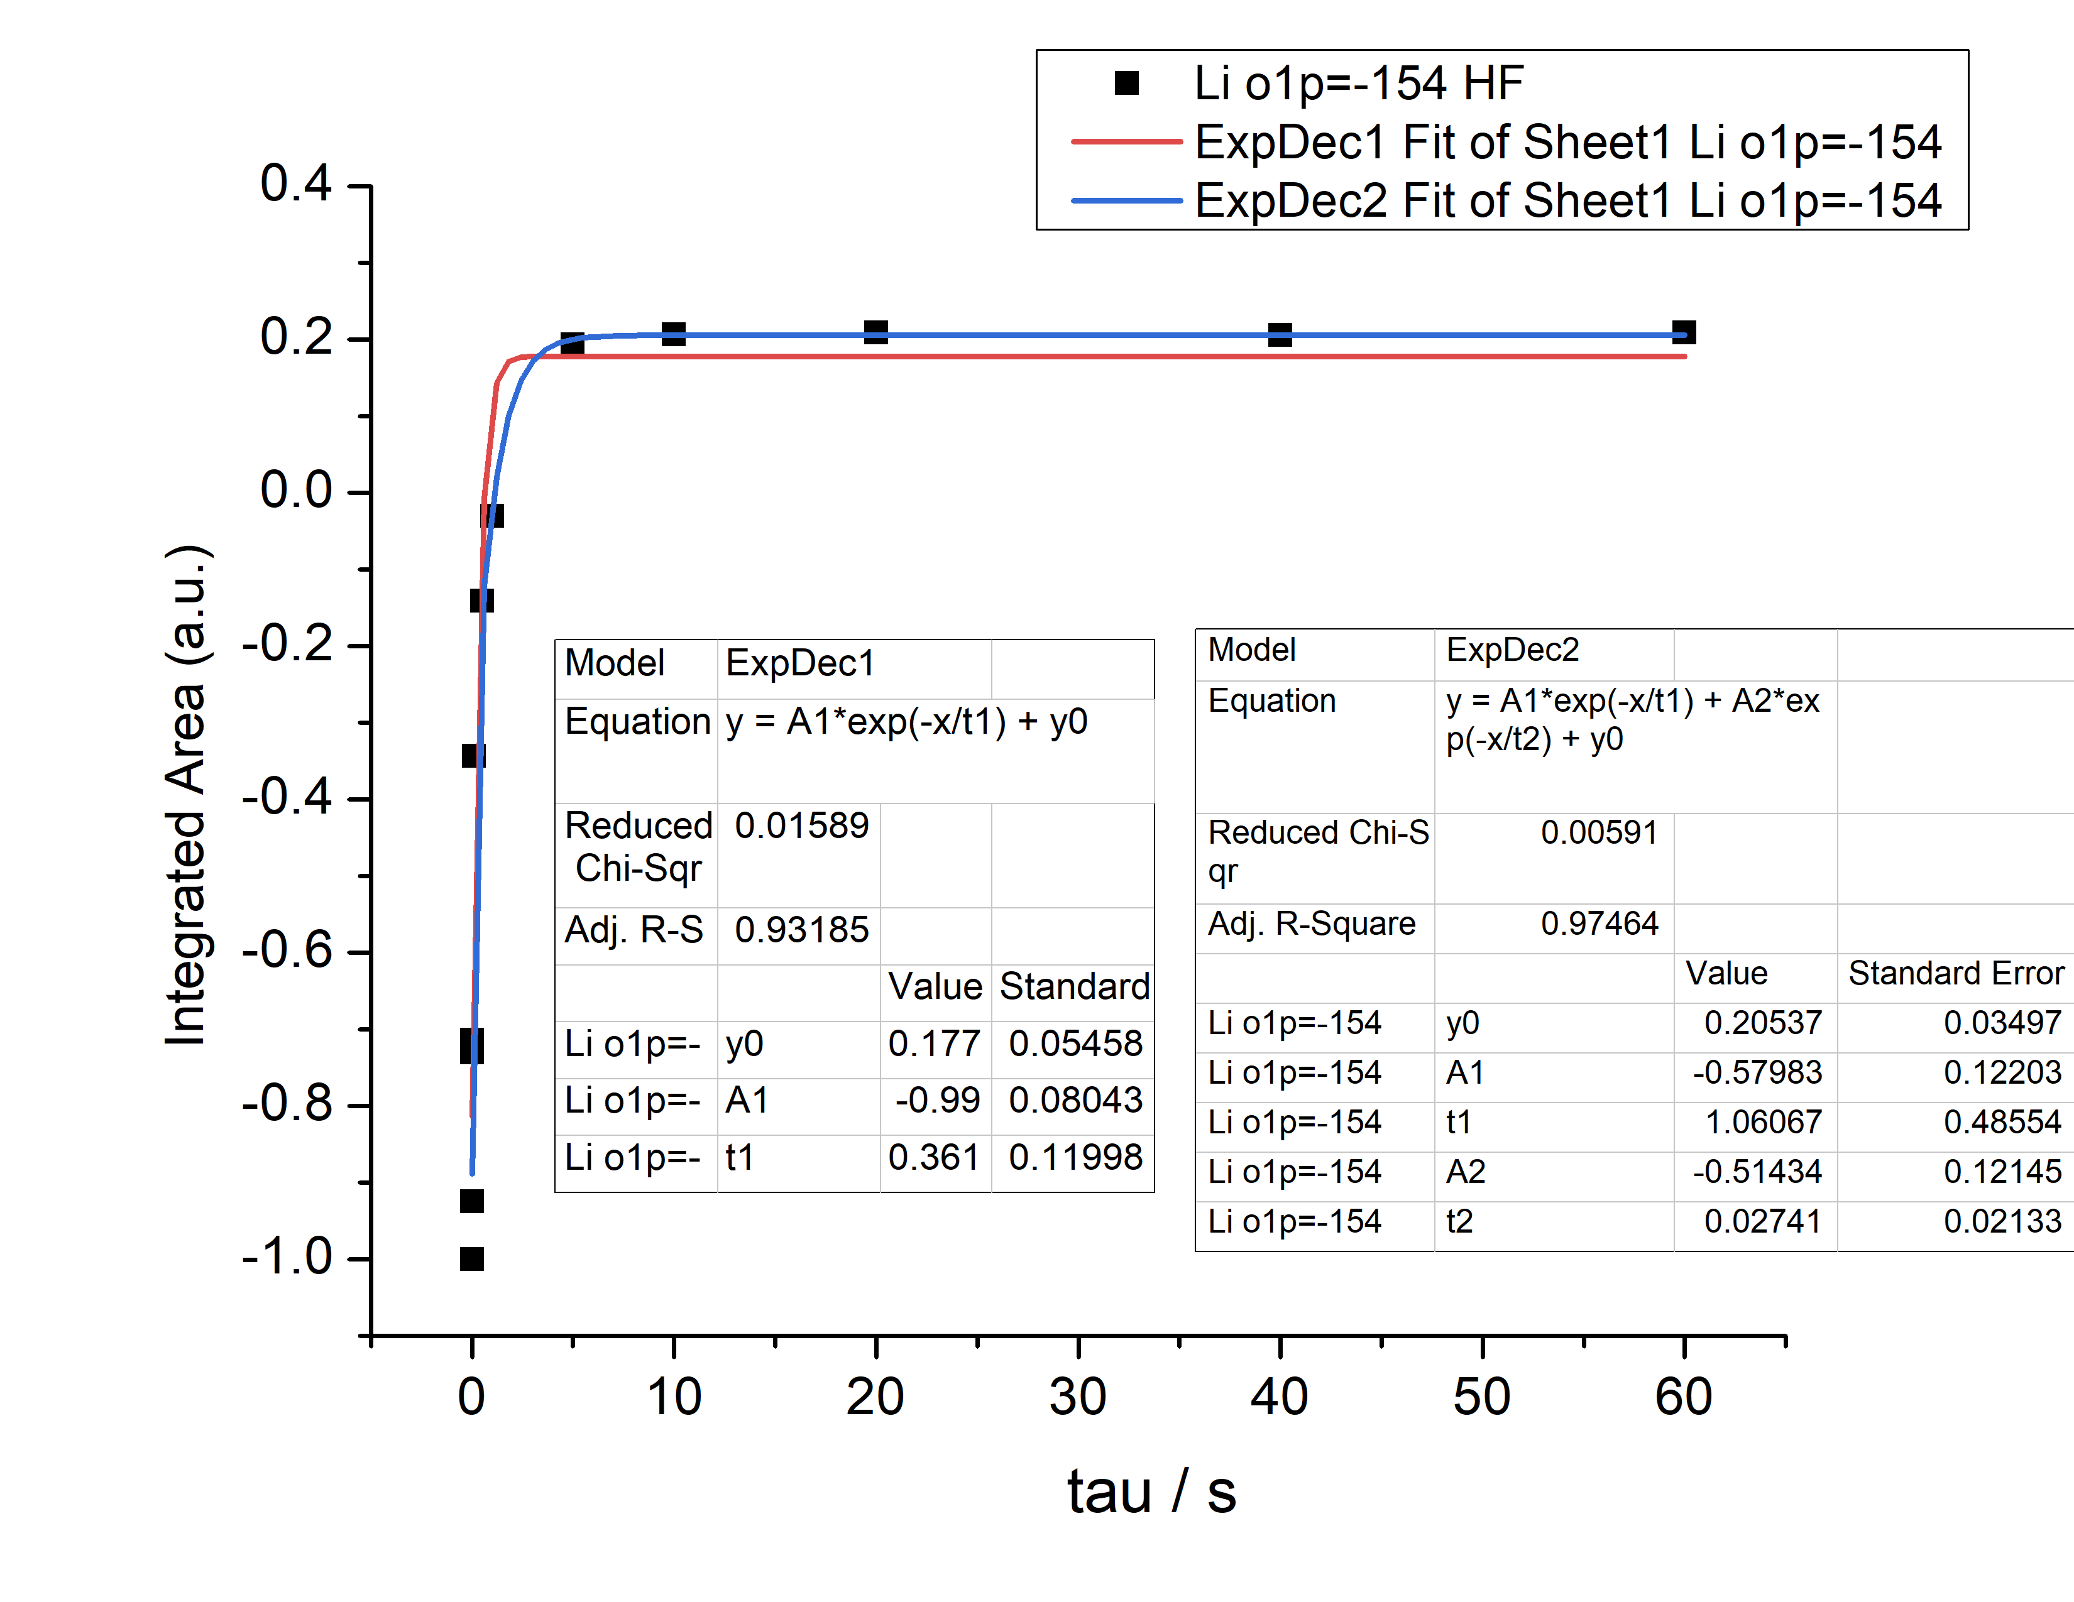
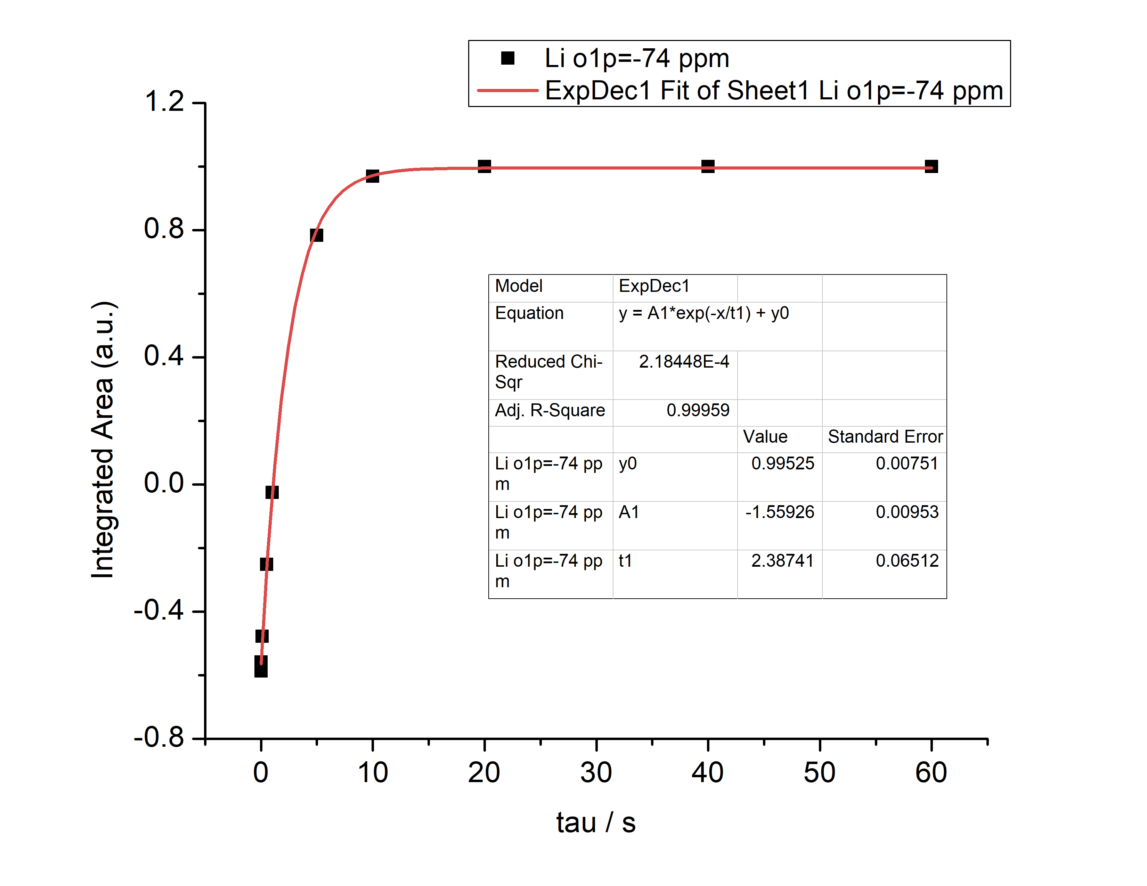

Slide 18
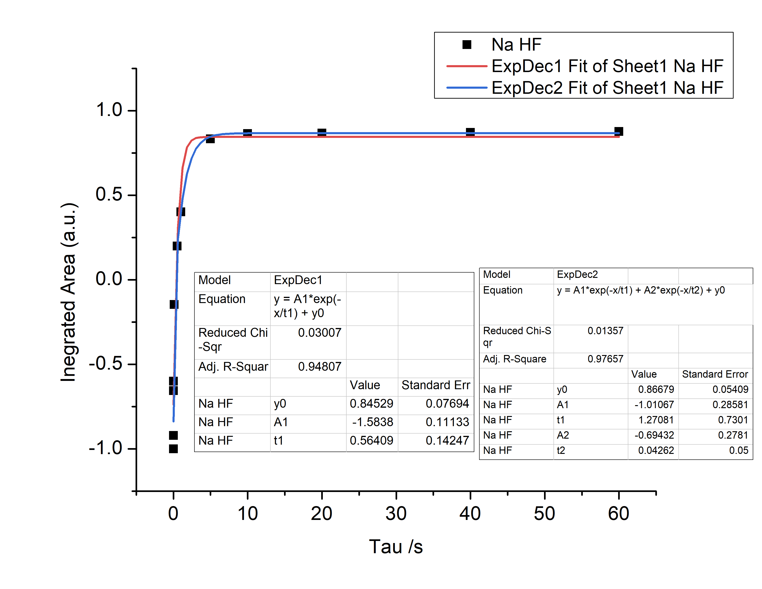
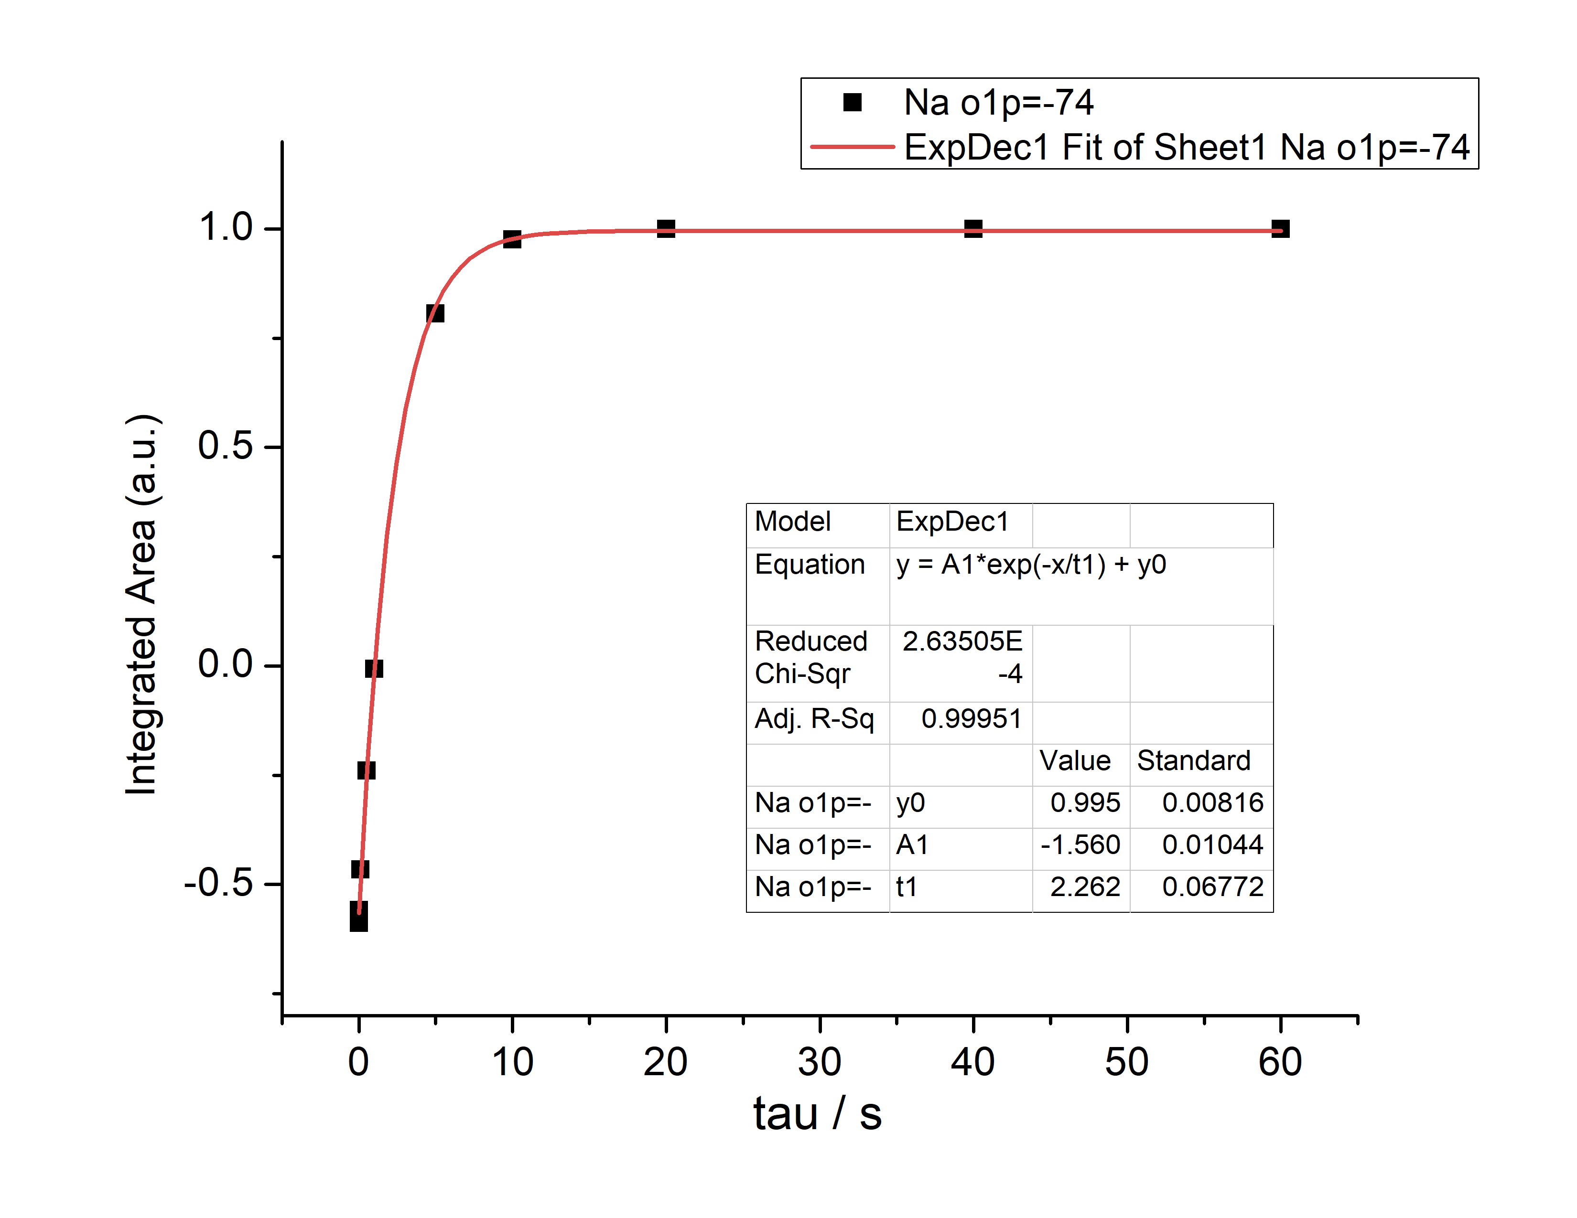

Slide 19
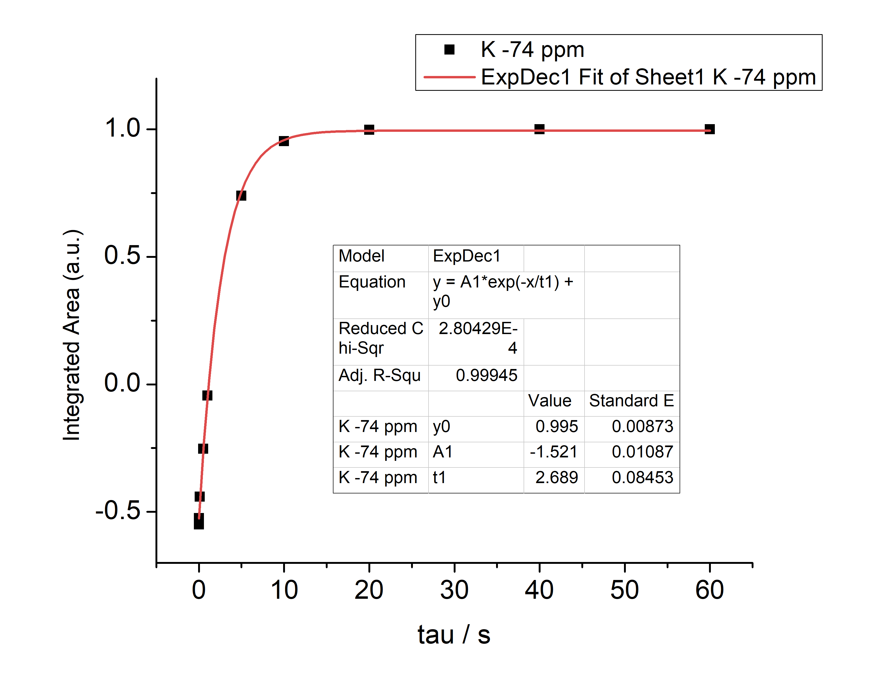

Slide 20
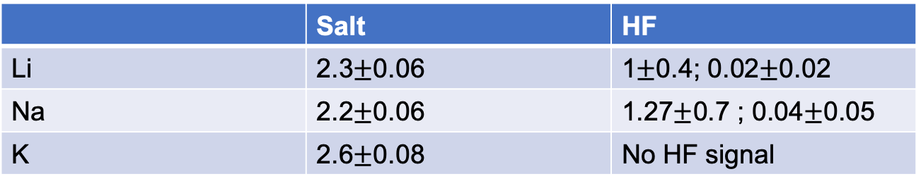
T₁ relaxation summary
 | Salt | HF
Li | 2.3$±$0.06 | 1$±$0.4; 0.02$±$0.02
Na | 2.2$±$0.06 | 1.27$±$0.7 ; 0.04$±$0.05
K | 2.6$±$0.08 | No HF signal

